Slide 1
ES 6 and React.js

Slide 2
Refreshing ES6 Specifications and Features
ECMAScript stands for European Computer Manufacturers Association Script
It lays out the specification and basic rule of language on which JavaScript is based on.
ES6/ECMAScript 2015 is the most commonly used specification to write JS/JSX code with a new set of keywords and operators.
Also known as JavaScript 6 as it is majorly derived from Netscape's JavaScript
ECMAScript has laid out a core object-oriented language to which Objects of any particular domain, or documents could be added

Slide 3
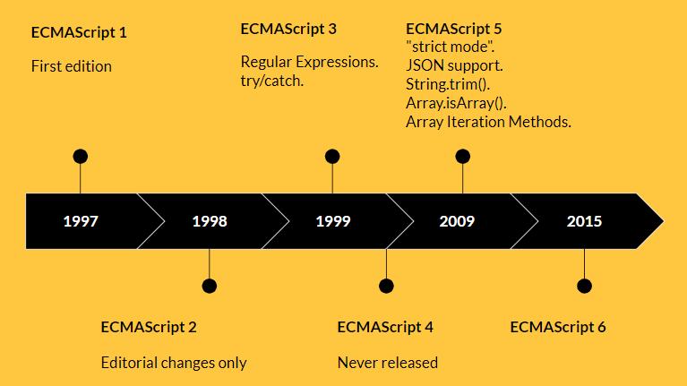
History of ECMAScript (ES) and JavaScript
JavaScript: A scripting language developed by Netscape in 1995, primarily for web browsers.
ECMAScript (ES): A standardized scripting language specification on which JavaScript is based.
ECMA International: The organization responsible for standardizing JavaScript through ECMAScript.
The development of the standard is still in progress.

Slide 4
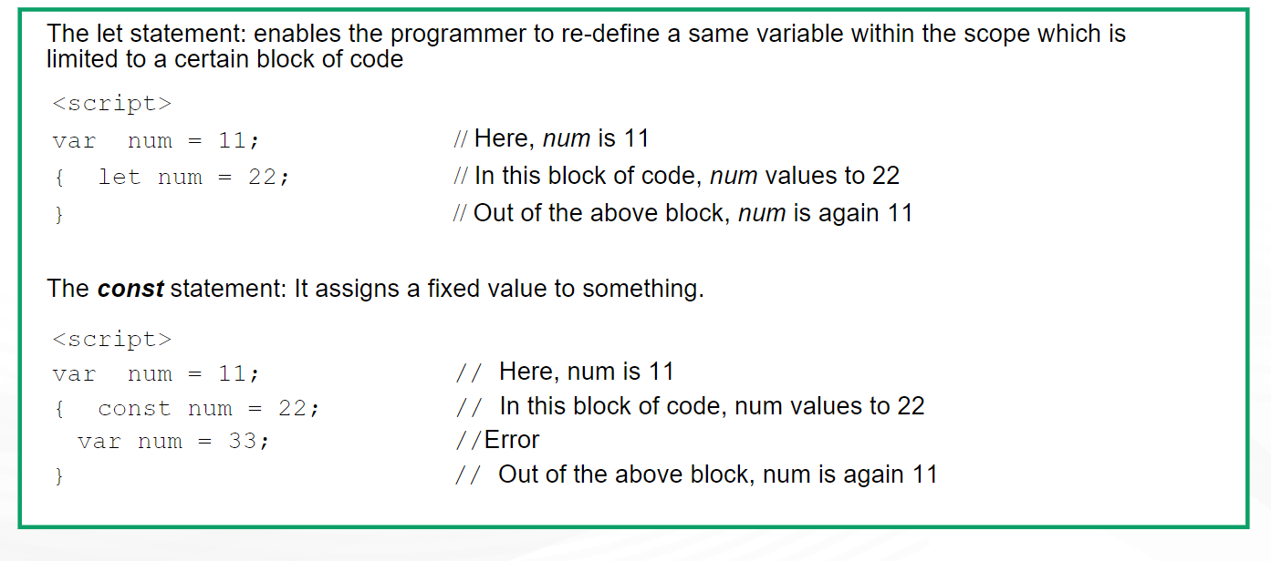
ES6- Let & Const

Slide 5
New Literal Syntax
Introduced a new way to handle strings with embedded expressions.
Enclosed by backticks (`), allowing multi-line strings and string interpolation using ${expression}.
Template literals are sometimes informally called template strings
let name = "Alice";
let greeting = `Hello, ${name}! Welcome to ES6.`;
console.log(greeting); // Output: Hello, Alice! Welcome to ES6.

Slide 6
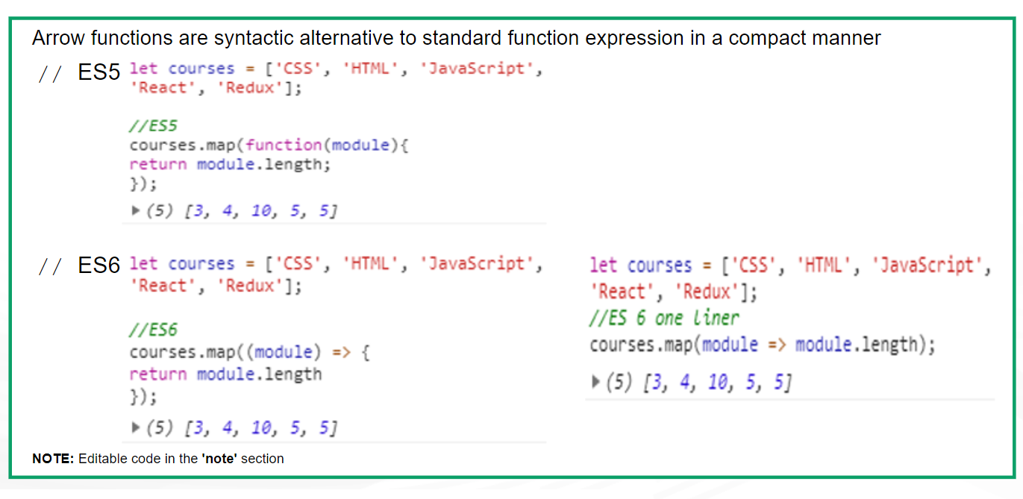
ES6: Arrow Function

Slide 7
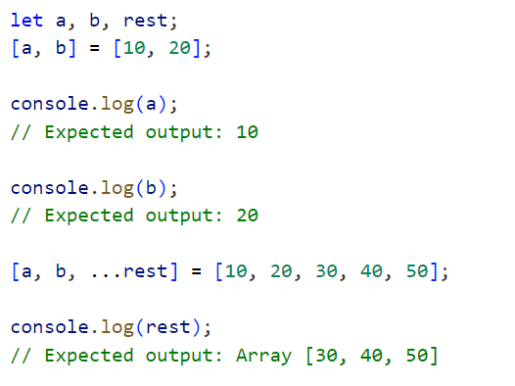
Object De-structuring
Allows unpacking values from arrays or properties from objects into distinct variables.
const person = { name: "Alice", age: 25 };
const { name, age } = person;

Slide 8
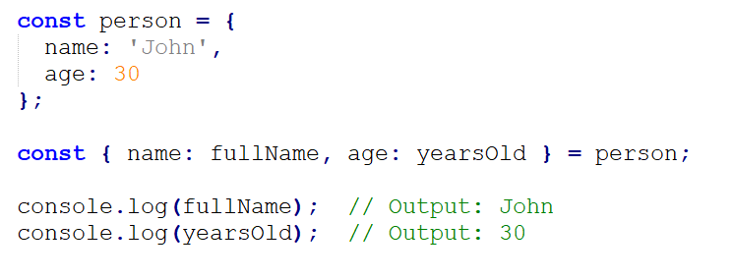
Renaming Variables During Destructuring
We can rename variables when destructuring:
The name property is extracted and stored in fullName, and age in yearsOld.

Slide 9
Syntax
const [a, b] = array;
const [a, , b] = array;
const [a, b, ...rest] = array;
const { a, b } = obj;
const { a, b, ...rest } = obj;

Slide 10
Callback Functions
A callback function is a function that is passed as an argument to another function and is executed after the completion of that function.
Callback functions are commonly used in asynchronous programming to ensure that a certain piece of code doesn’t execute until another piece has finished executing.
Synchronous vs. Asynchronous Callbacks:
Synchronous Callbacks: These are executed immediately within the function in which they are passed.
Asynchronous Callbacks: These are used for tasks like fetching data or reading a file, and they are executed once the task is completed.

Slide 11
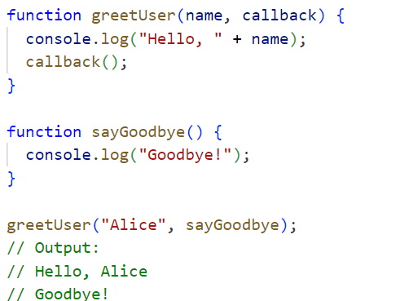
Synchronous Callback:

Slide 12
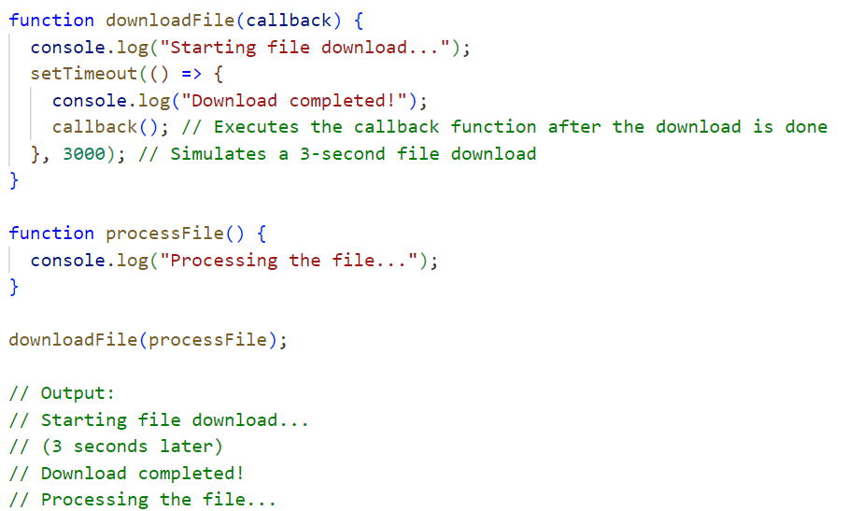
Asynchronous Callback

Slide 13
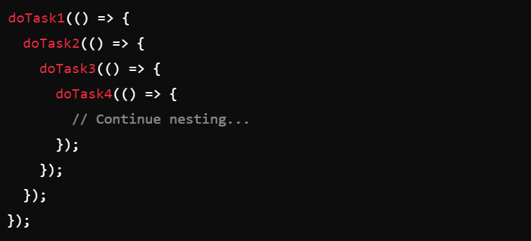
Callback Hell (Pyramid of Doom)
When dealing with multiple asynchronous operations using callbacks, you can run into a situation called callback hell. This occurs when callbacks are nested within callbacks, leading to deeply indented and hard-to-read code.

Slide 14
Promises
A Promise in JavaScript is an object representing the eventual completion or failure of an asynchronous operation.
Promises allow you to write asynchronous code in a more readable and structured way, avoiding callback hell.

Slide 15
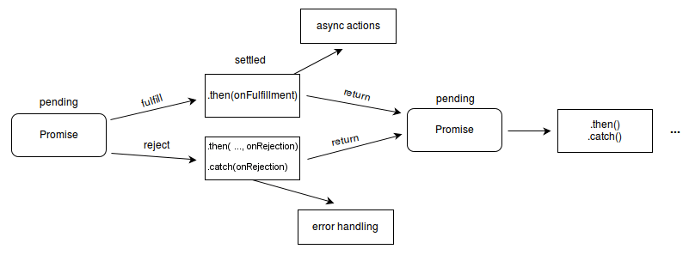
States of a Promise:
Pending: The initial state of the promise, before the result is known.
Fulfilled: The operation completed successfully, and the promise has a result.
Rejected: The operation failed, and the promise has a reason for the failure.

Slide 16
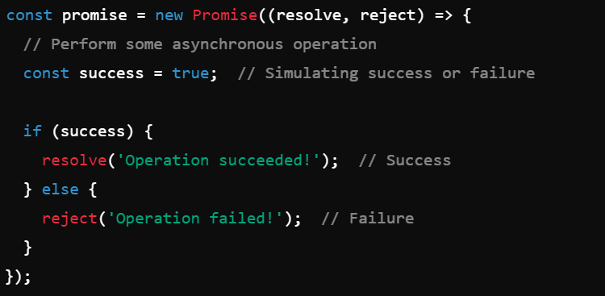
Creating a Promise
A promise is created using the Promise constructor, which takes a function with two parameters: resolve (for success) and reject (for failure).

Slide 17
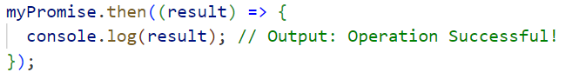
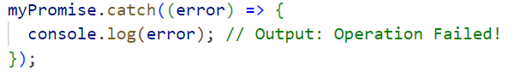
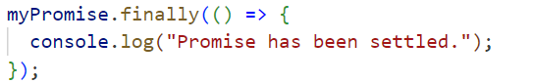
Handling Promises
.then():
Used to handle the result of a successful promise (fulfilled state).Takes one argument( a function to run when the promise resolves).
.catch()
Used to handle errors (rejected state).Takes one argument (a function to run when the promise is rejected)
.finally()
This is an optional method that runs regardless of whether the promise is resolved or rejected.

Slide 18
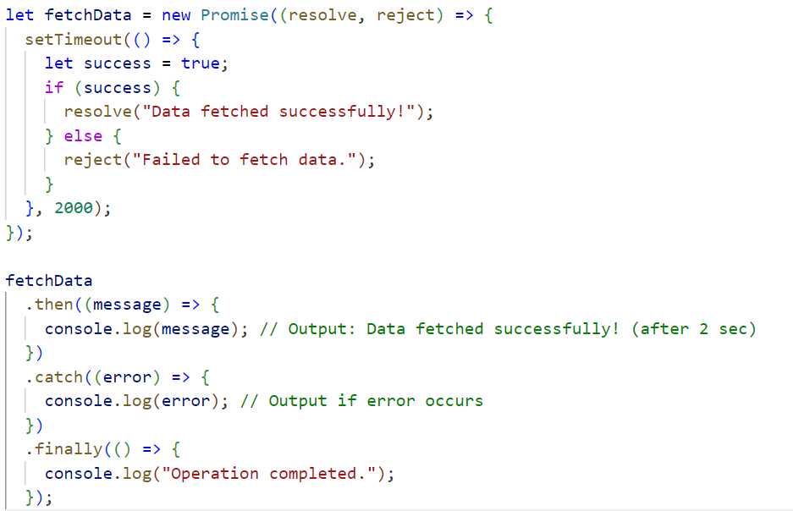

Slide 19
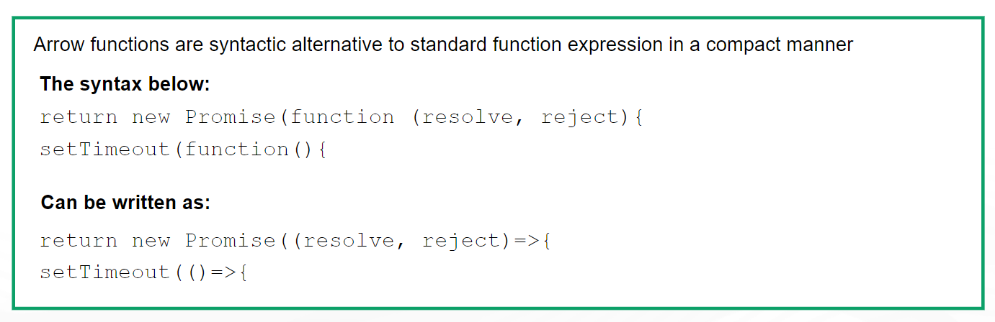
=> In Promises

Slide 20
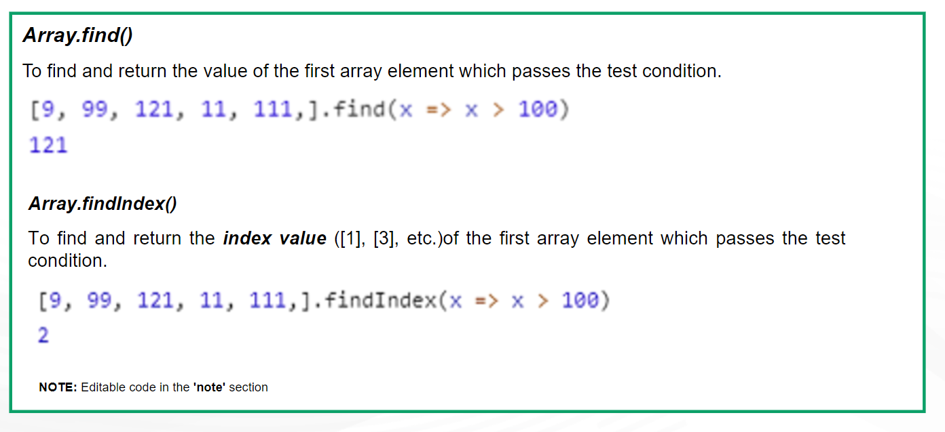
ES6: New Built-in Methods

Slide 21
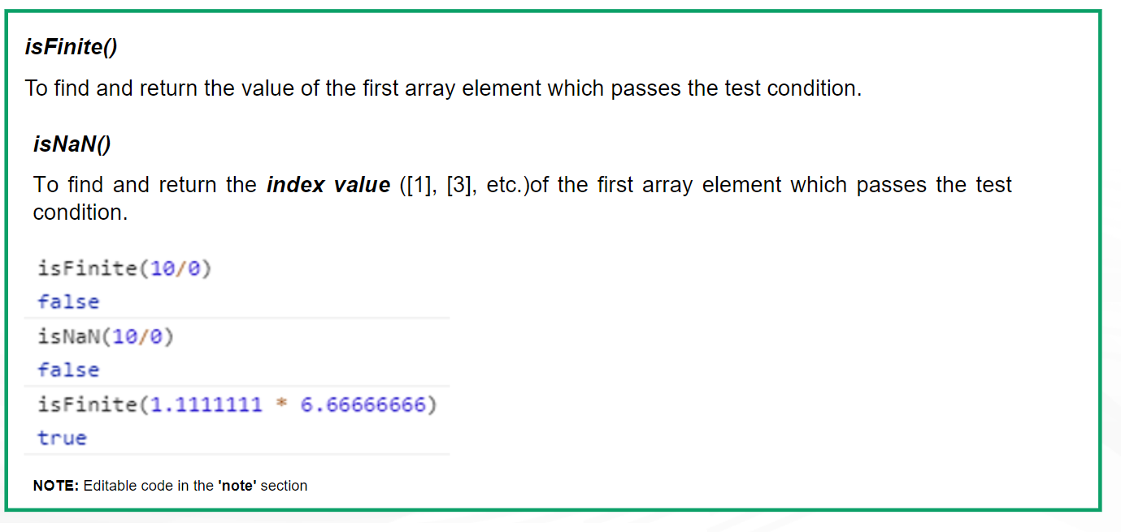
ES6: Number Type Checking

Slide 22
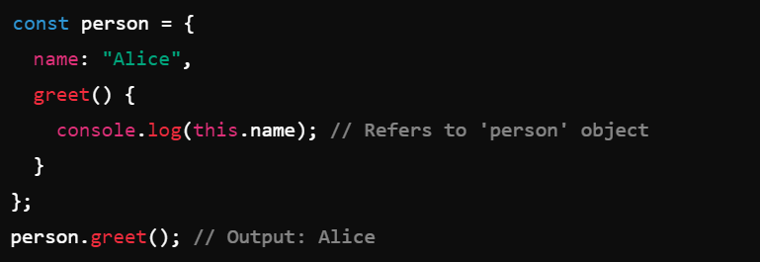
this keyword
The this keyword refers to the current context of execution. It allows access to properties and methods within an object or function depending on where it is used.
The value of this depends on how a function is called, not where it is defined.
In the global execution context (outside of any function), this refers to the global object, which is window in a browser. EG: console.log(this); // Refers to the global window object in the browser.
When this is used inside a method of an object, it refers to the object itself.

Slide 23
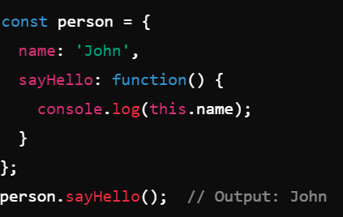
Global Context (Outside Any Function):
When this is used in the global scope (i.e., outside of any function or object), it refers to the global object.
window in browsers, global in Node.js
Inside an Object Method:
When this is used inside an object's method, it refers to the object that owns the method.

Slide 24
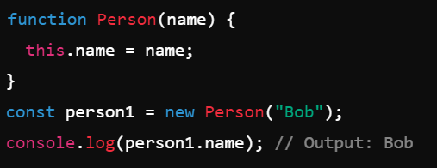
In a constructor function, this refers to the newly created object (the instance).
Arrow functions do not bind their own this. Instead, they inherit this from their surrounding lexical context.
In event listeners, this typically refers to the element that received the event.

Slide 25
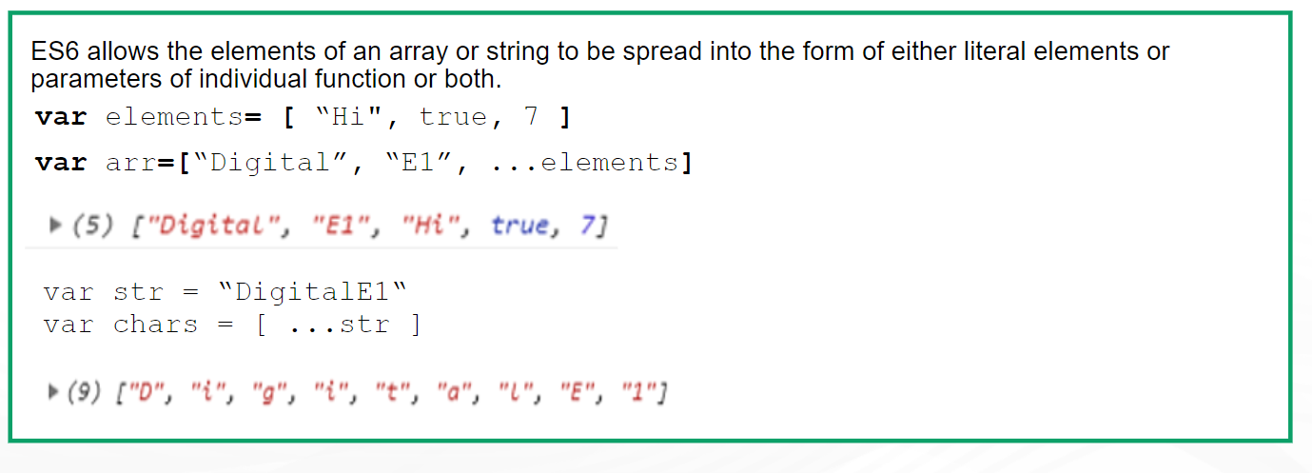
Spread Operator (…)

Slide 26
Spread Operator (…)
The spread operator (...) in JavaScript is a powerful feature introduced in ES6 (ECMAScript 2015)
It allows an iterable (like an array or an object) to be expanded or spread into individual elements.
It can be used in various contexts, such as function calls, array literals, and object literals.

Slide 27
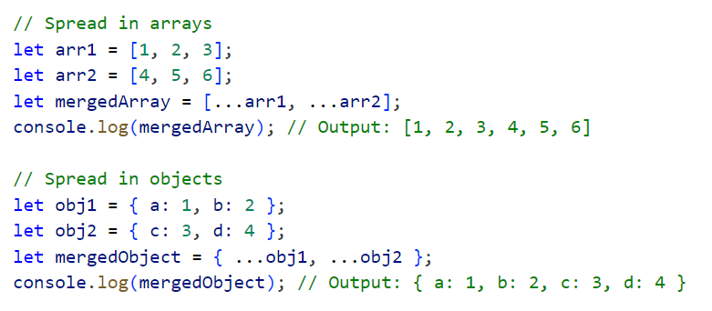

Slide 28
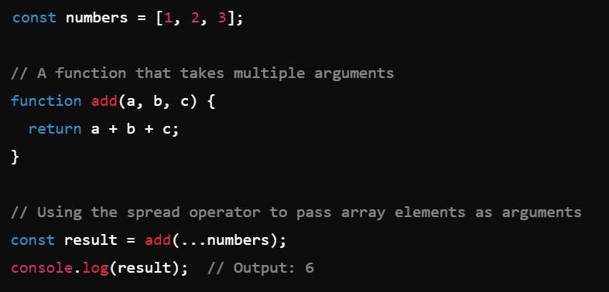
We can use the spread operator to pass elements of an array as arguments to a function.

Slide 29
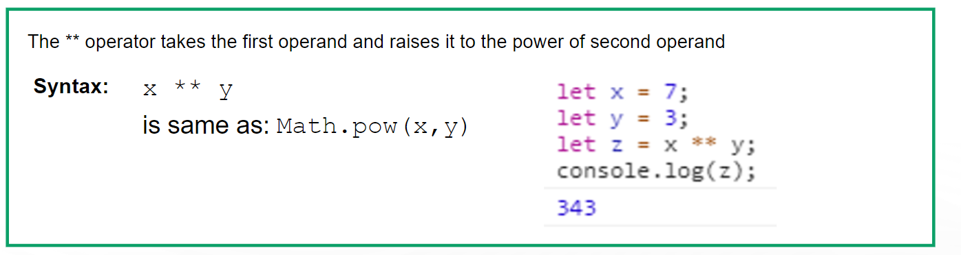
Exponential Operator (**)

Slide 30
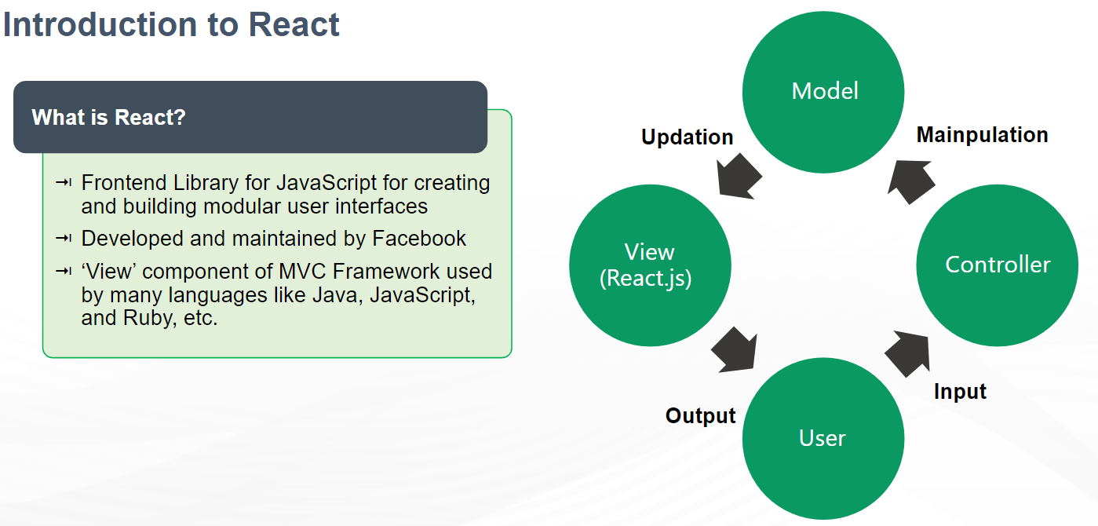

Slide 31

Features of React

Slide 32
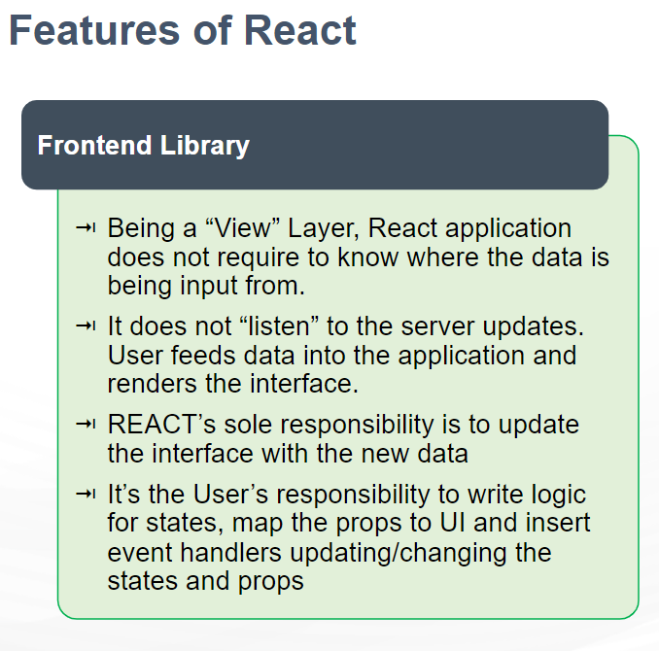

Slide 33
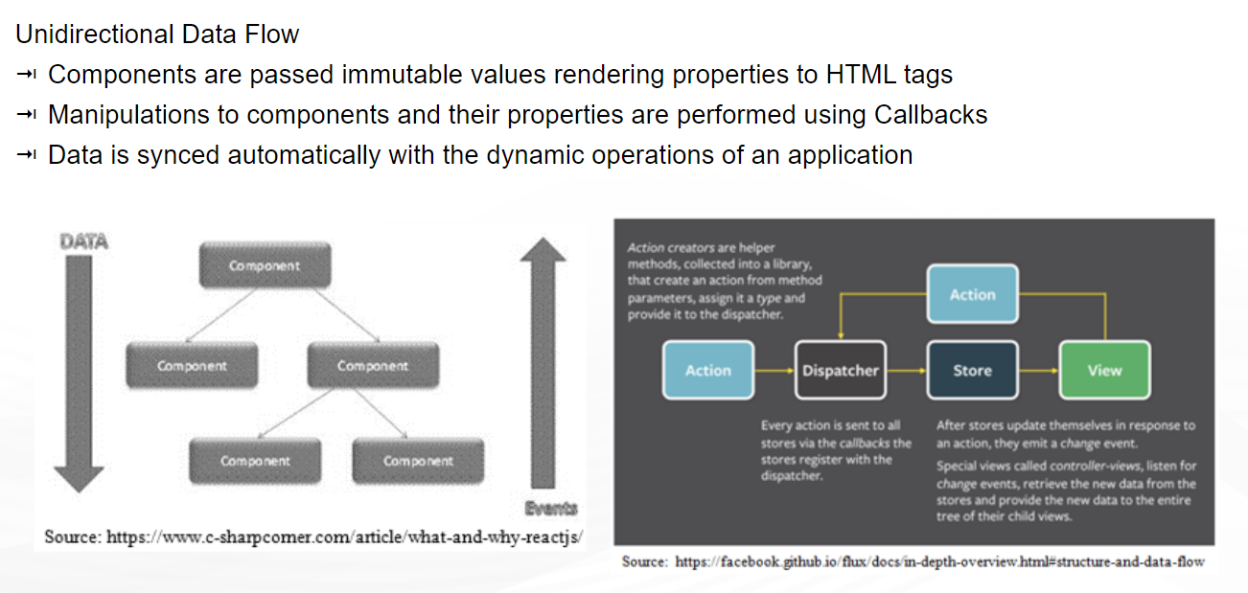

Slide 34
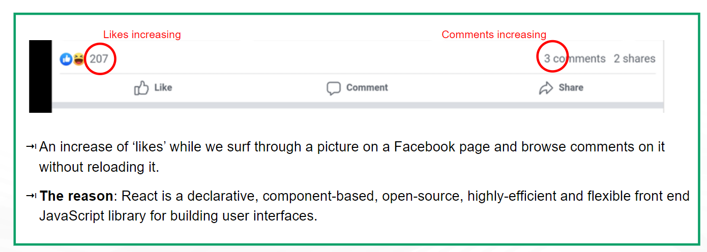
Practical Application

Slide 35

Why we Need React?

Slide 36
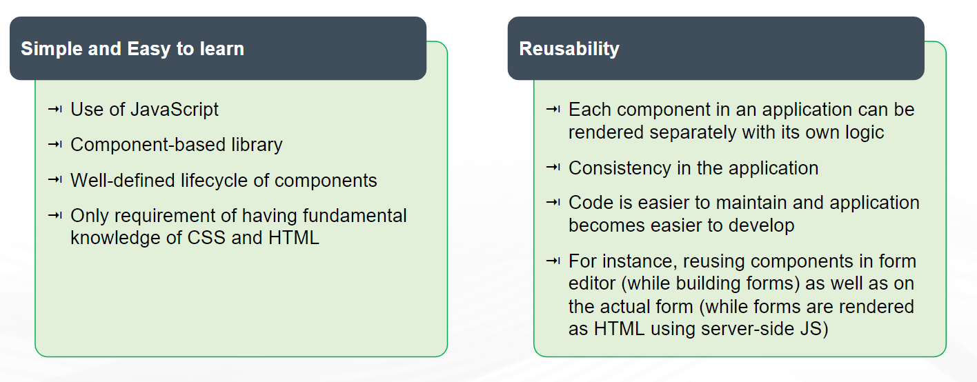

Slide 37
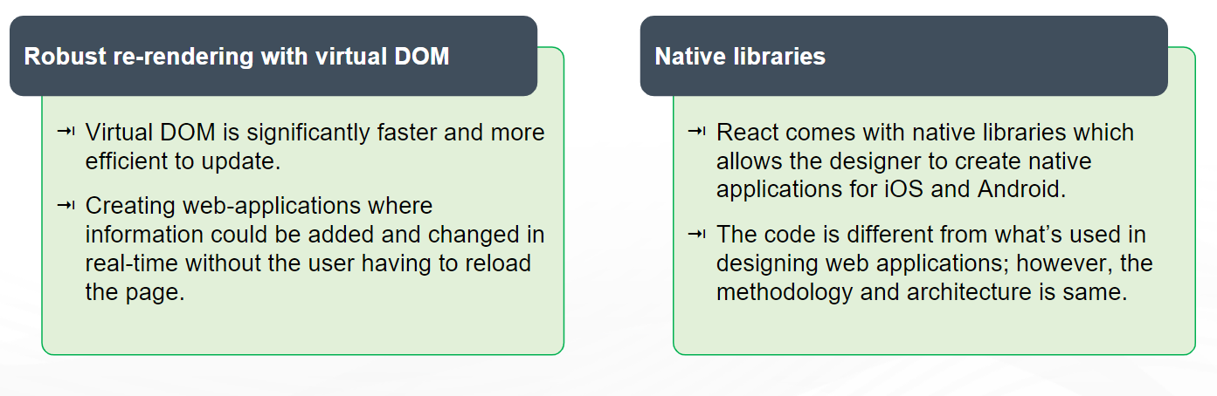

Slide 38
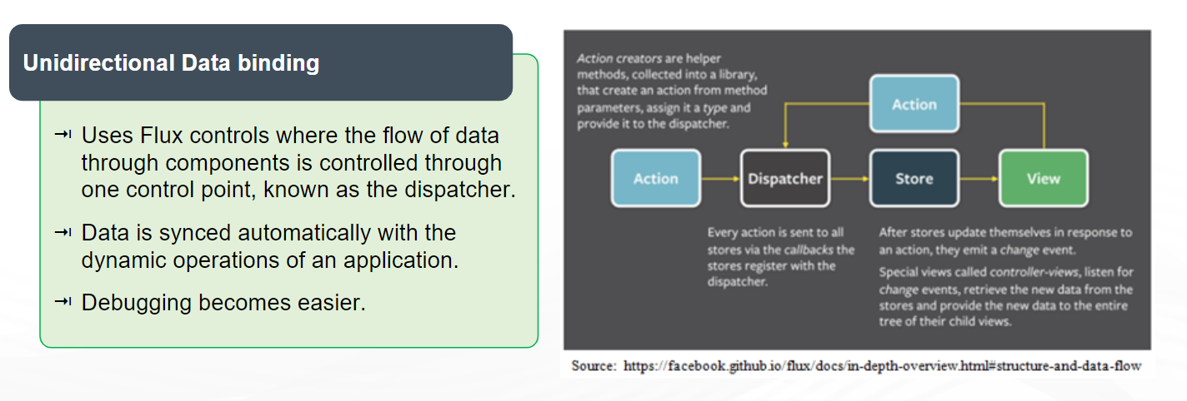

Slide 39
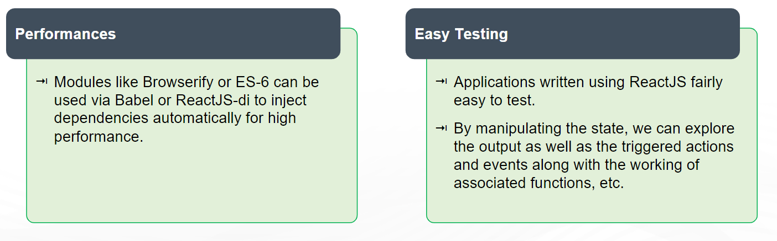

Slide 40
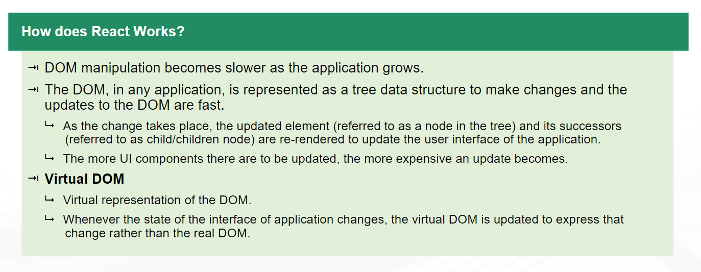
How does React Works?

Slide 41
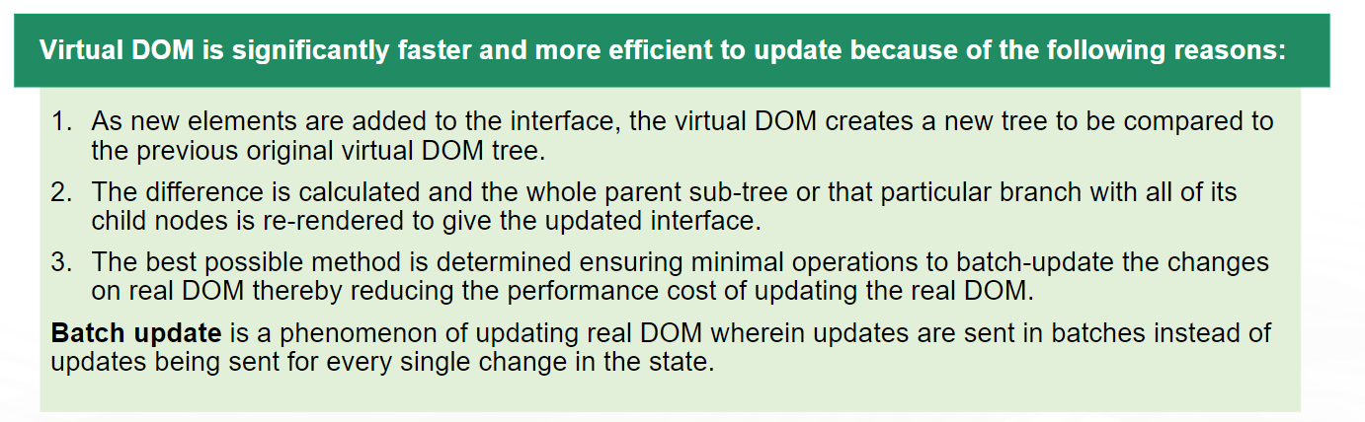

Slide 42
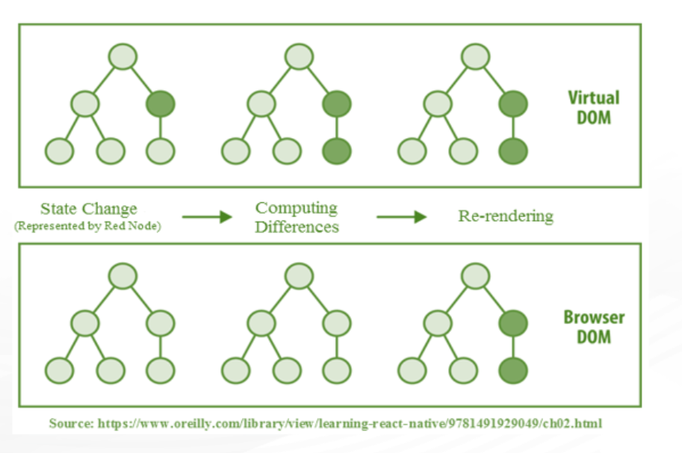

Slide 43
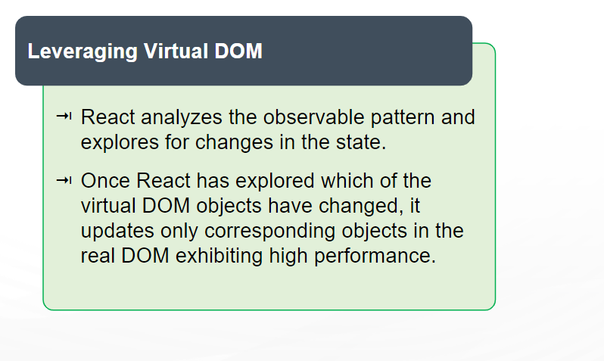

Slide 44
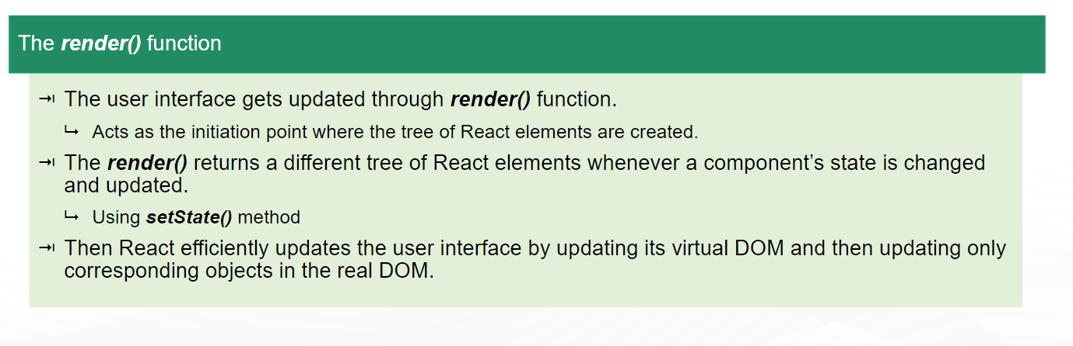

Slide 45
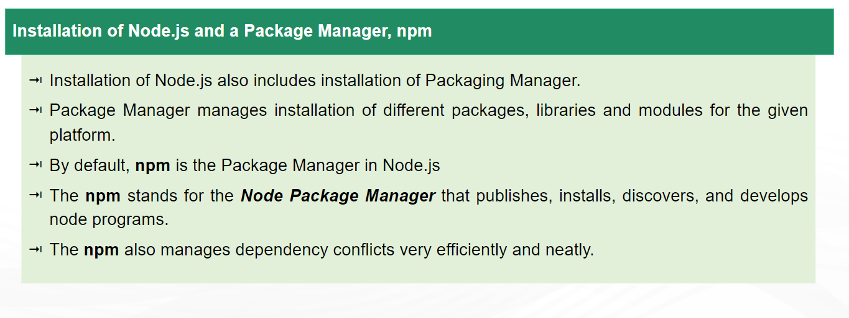
Setting up React

Slide 46
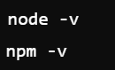
1. Install Node.js and npm
React requires Node.js and npm (Node Package Manager) to manage dependencies.
Download and install Node.js from the official site: https://nodejs.org.
After installation, verify the installation by checking the versions of Node.js and npm in your terminal/command prompt:

Slide 47

2. Install create-react-app
create-react-app is an official command-line tool to set up a new React project quickly.
Open your terminal/command prompt and run the following command to install it globally:

Slide 48

3. Navigate to Your Project Folder
Once the installation is complete, navigate to the project folder using the cd (change directory) command:

Slide 49

4. Start the React Development Server
To run the React app, execute the following command in your terminal/command prompt:
This will start the development server.
The app will automatically open in your default browser at http://localhost:3000.
If the browser doesn’t open automatically, you can manually open this URL.

Slide 50
5. Explore the Project Structure
Once the app is running, you can explore the files created by create-react-app:
public/: Contains the index.html file.
src/: Contains the main code, including App.js where you can start modifying your React components.

Slide 51
